Slide 1
DELTA HEDGING

Slide 2
EXAMPLE
A bank has sold for $300,000 a European call option on 100,000 shares of a non-dividend paying stock
S₀ = 49, K = 50, r = 5%, σ = 20%,
T = 20 weeks, μ = 13%
The Black-Scholes value of the option is =?
How does the bank hedge its risk to lock in a ------------------?profit?

Slide 3
NAKED & COVERED POSITIONS
Naked position
Take no action
Covered position
Buy 100,000 shares today
Both strategies leave the bank exposed to significant risk

Slide 4
STOP-LOSS STRATEGY
This involves:
Buying 100,000 shares as soon as price reaches $50
Selling 100,000 shares as soon as price falls below $50
This deceptively simple hedging strategy does not work well

Slide 5
DELTA
Delta (Δ) is the rate of change of the option price with respect to the underlying
Option
price
Slope = Δ
B
A
Stock price

Slide 6
DELTA HEDGING
This involves maintaining a delta neutral portfolio
The delta of a European call on a non-dividend paying stock is N (d ₁)
The delta of a European put on the stock is
N (d ₁) – 1

Slide 7
DELTA HEDGING
CONTINUED
The hedge position must be frequently rebalanced
Delta hedging a written option involves a “buy high, sell low” trading rule
examples of delta hedging- Refer Excel

Slide 8
THETA
Theta (Θ) of a derivative (or portfolio of derivatives) is the rate of change of the value with respect to the passage of time
The theta of a call or put is usually negative. This means that, if time passes with the price of the underlying asset and its volatility remaining the same, the value of a long option declines

Slide 9
GAMMA
Gamma (Γ) is the rate of change of delta (Δ) with respect to the price of the underlying asset
Gamma is greatest for options that are close to the money

Slide 10
GAMMA ADDRESSES DELTA HEDGING ERRORS CAUSED BY CURVATURE
(FIGURE 17.7, PAGE 369)
Call
price
C''
C'
C
Stock price
S
S'

Slide 11
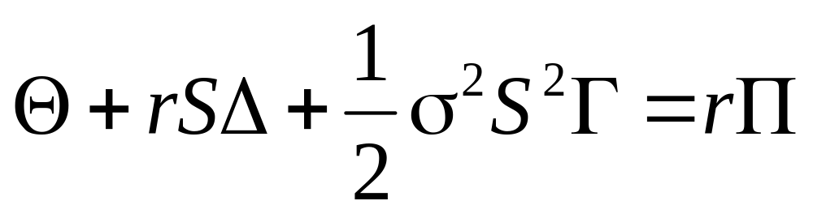
RELATIONSHIP BETWEEN DELTA, GAMMA, AND THETA (PAGE 373)
For a portfolio of derivatives on a stock paying a continuous dividend yield at rate q

Slide 12
VEGA
Vega (ν) is the rate of change of the value of a derivatives portfolio with respect to volatility
Vega tends to be greatest for options that are close to the money

Slide 13
MANAGING DELTA, GAMMA, & VEGA
Δ can be changed by taking a position in the underlying
To adjust Γ & ν it is necessary to take a position in an option or other derivative

Slide 14
RHO
Rho is the rate of change of the value of a derivative with respect to the interest rate

Slide 15
HEDGING IN PRACTICE
Traders usually ensure that their portfolios are delta-neutral at least once a day
Whenever the opportunity arises, they improve gamma and vega
As portfolio becomes larger hedging becomes less expensive

